Slide 1
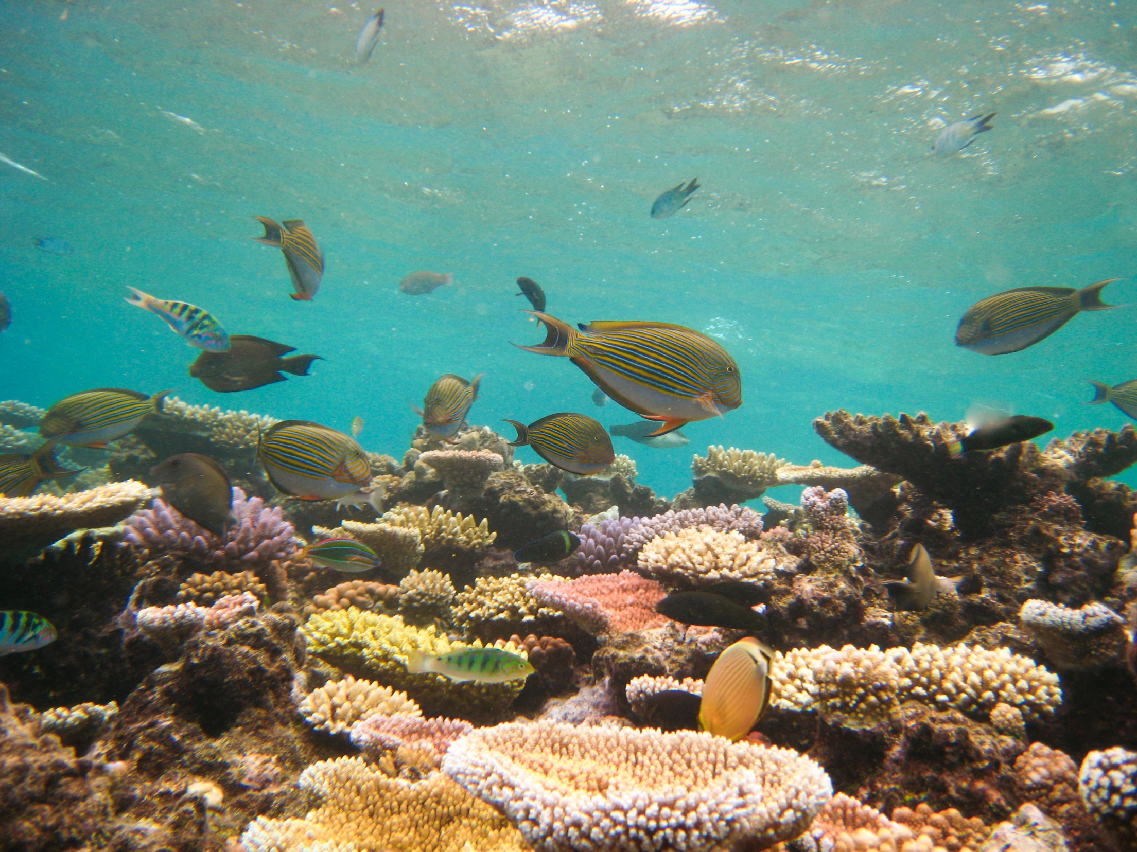

Inference for multivariate abundance data: glmm & the PIT-trap
Loïc Thibaut, David Warton

Slide 2
EagleHawk Neck copepods
 | 1 | 2 | 3 | 4 | …
B1 | 0 | 10 | 0 | 0
B1 | 0 | 9 | 0 | 0
B1.t | 0 | 51 | 0 | 2
B1.t | 2 | 48 | 0 | 2
B2 | 0 | 6 | 14 | 0
B2 | 1 | 0 | 7 | 0
B2.t | 0 | 9 | 1 | 8
B2.t | 0 | 5 | 0 | 2
…
Design
4 blocks, 2 treatments, 2 replicates
Observations
Counts for 12 species
Test for:
Treatment effect
Block:treatment interaction
Using mixed effects models
Notes:
Scientists collect multivariate abundance data to assess the effect of stuff on community structure. Here interested by the effect of the soldier crab on the meio-fauna community structure.
Meio fauna: randomized block design: 4 blocks, 2 treatments

Slide 3
Multivariate abundance data
Some important characteristics:
Counts, proportions, presence/absence
Species’ abundances are correlated
number of species (p) is not small compared to n
Covariance of abundances among species is hard to estimate
Model selection based on asymptotic theory is unreliable

Slide 4
Aims
Develop methods for inference with glmm for multivariate abundance data
Develop bootstrap procedure robust to misspecification of the correlation structure
Assess the performance with simulations
Compare with distance-based approaches

Slide 5
Bootstrap for inference
_
+
parametric bootstrap
Simulate from fitted null model
semi-parametric bootstrap
Resample the residuals
non-parametric bootstrap
Resample the data (“case resampling”)
Robustness
Assumptions
_
+
Notes:
Strength of assumptions decreases top to bottom.
Ecology: models are always misspecified. In particular species are not independent of each other, and correlation is misspecified

Slide 6
Bootstrap for inference
_
+
parametric bootstrap
Sensitive to model misspecification
semi-parametric bootstrap
Robust, keeps design fixed
non-parametric bootstrap
Does not keep the design fixed
Robustness
Assumptions
_
+
We need a generic residual-resampling procedure for glmm
Notes:
Strength of assumptions decreases top to bottom.
Ecology: models are always misspecified. In particular species are not independent of each other, and correlation is misspecified

Slide 7
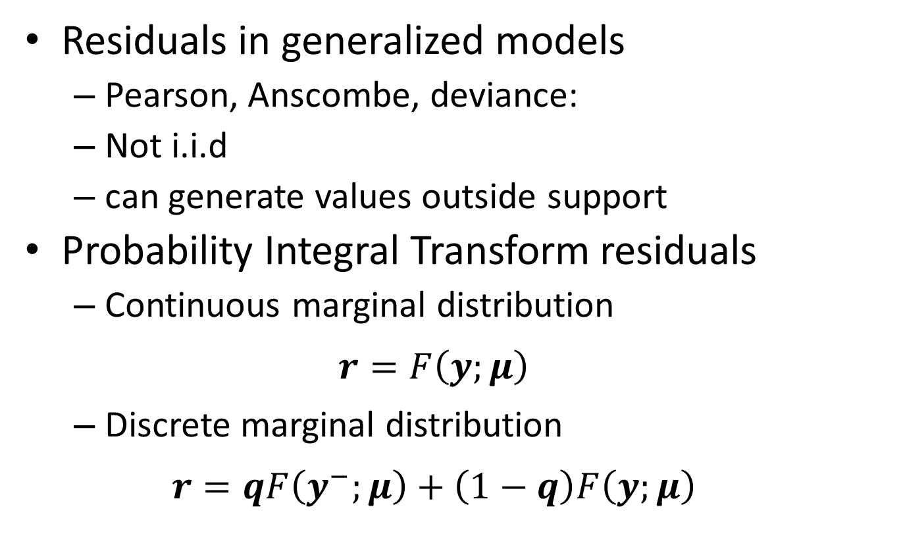
Residuals resampling for glm
Residuals in generalized models
Pearson, Anscombe, deviance:
Not i.i.d
can generate values outside support
Probability Integral Transform residuals
Continuous marginal distribution
$$r=F\left(y;μ\right)$$
Discrete marginal distribution
$$r=qF\left(y^{−};μ\right)+\left(1−q\right)F\left(y;μ\right)$$
Notes:
Not obvious how to define residuals for non-Gaussian regression models

Slide 8
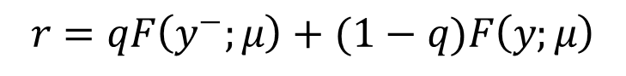
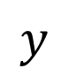
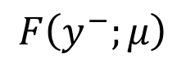
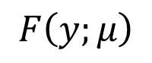
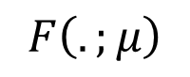
$$F\left(.;μ\right)$$
1.0
$$r=qF\left(y^{−};μ\right)+(1−q)F\left(y;μ\right)$$
$$F\left(y;μ\right)$$
$$F\left(y^{−};μ\right)$$
0.0
$$y$$
0
2
4
6
8
10
Notes:
Black cumulative distribution function of interest, example Poisson for a Poisson glm
Distribute uniformly the probability mass between these two values by taking a weighted average with random weight

Slide 9
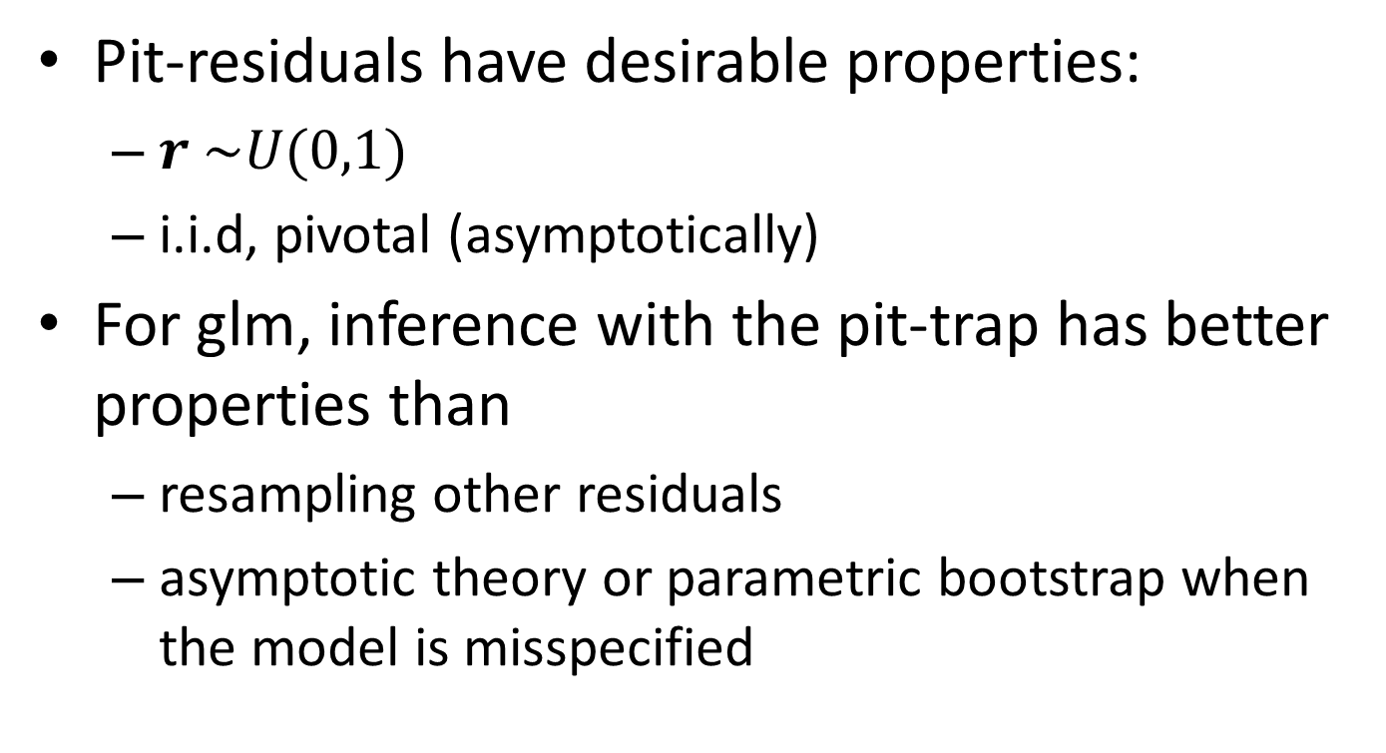
PIT-residuals and the PIT-trap
Pit-residuals have desirable properties:
$r \sim U(0,1)$
i.i.d, pivotal (asymptotically)
For glm, inference with the pit-trap has better properties than
resampling other residuals
asymptotic theory or parametric bootstrap when the model is misspecified

Slide 10
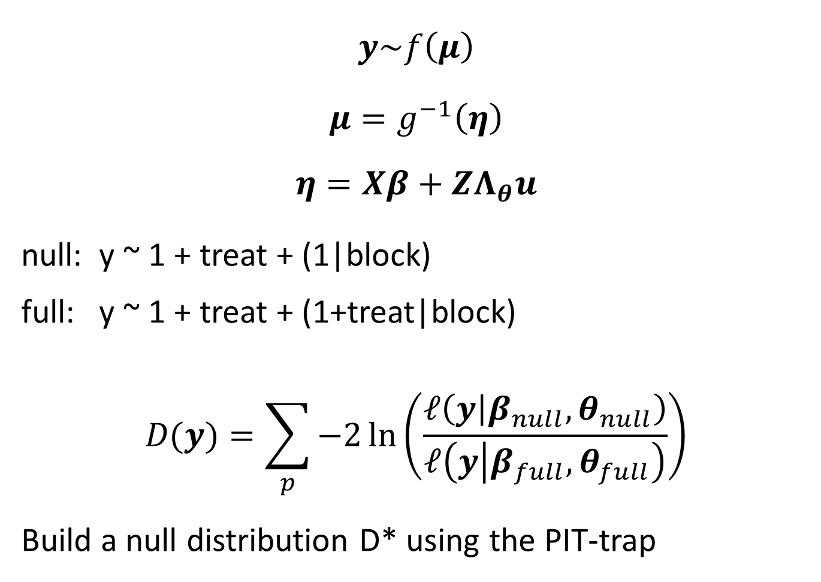
Poisson glmm for Eaglehawk neck data
$$y\sim f\left(μ\right)$$
$$μ=g^{−1}\left(η\right)$$
$$η=Xβ+ZΛ_{θ}u$$
null: y ~ 1 + treat + (1|block)
full: y ~ 1 + treat + (1+treat|block)
$$D(y)=\sum_{p}{−2\ln\left(\frac{𝓁\left(y | β_{null},θ_{null}\right)}{𝓁\left(y | β_{full},θ_{full}\right)}\right)}$$
Build a null distribution D* using the PIT-trap
Notes:
Location parameter mu

Slide 11
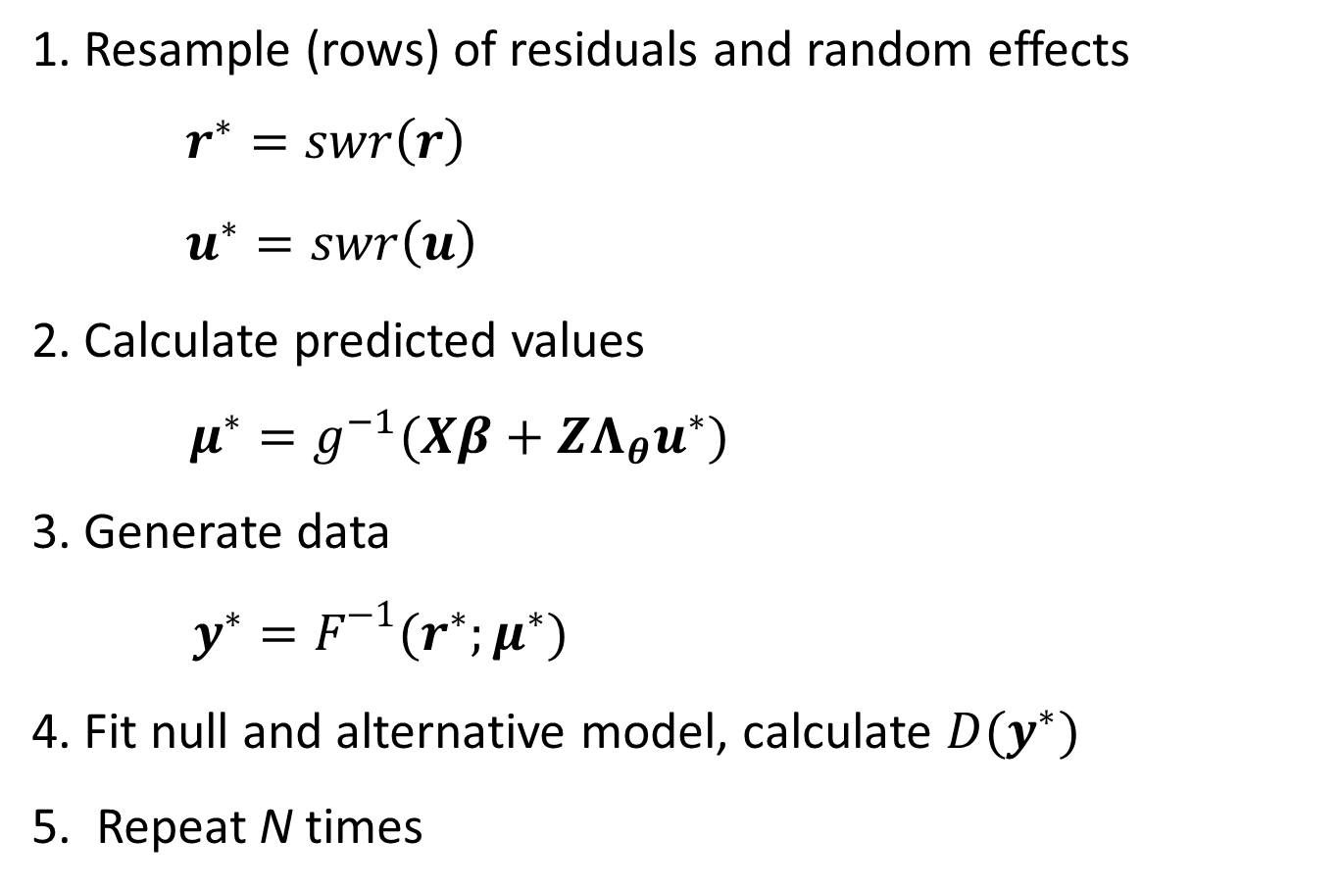
PIT-trap for glmm
1. Resample (rows) of residuals and random effects
$r^{∗}=swr\left(r\right)$
$u^{∗}=swr\left(u\right)$
2. Calculate predicted values
$μ^{∗}=g^{−1}(Xβ+ZΛ_{θ}u^{∗})$
3. Generate data
$y^{∗}=F^{−1}(r^{∗};μ^{∗})$
4. Fit null and alternative model, calculate $D(y^{∗})$
5. Repeat N times

Slide 12
Type I error: simulation study
Poisson-distributed abundances
12 species, uncorrelated
Blocks in {5, 15, 50, 200}
Replicates in {2, 5}
Simulate 500 datasets from null model
Estimated Type I error rate for
Parametric bootstrap
Pit-trap

Slide 13
Type I error: simulation study
0.20
0.15
TypeI error rate
0.10
0.05
0.00
5
10
20
50
100
200
number of blocks
Notes:
Parametric bootstrap is our gold standard. Type error is too high, and increases with sample size

Slide 14
What went wrong ?
Distribution of PIT-residuals

Slide 15
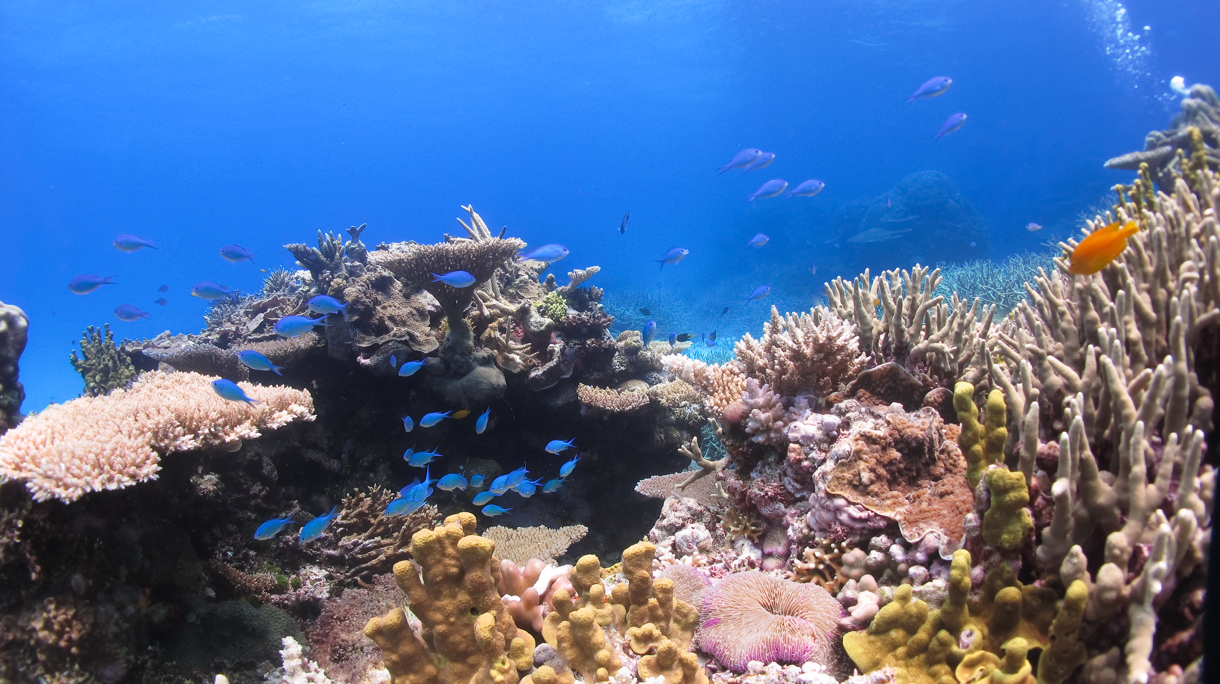
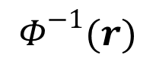
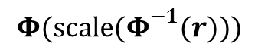
Dunn Smyth residuals
PIT-residuals
$$Φ^{−1}(r)$$
0.0
0.2
0.4
0.6
0.8
1.0
-3
-2
-1
0
1
2
3
rescaled Dunn Smyth residuals
rescaled PIT-residuals
0.4
0.3
0.2
0.1
00
-4
-2
0
2
4
0.0
0.2
0.4
0.6
0.8
1.0
$${Φ(scale(Φ}^{−1}(r)))$$

Slide 16
What went wrong ?
Distribution of PIT-residuals
Distribution of random effects

Slide 17
random effects
scaled random effects
rescale
-3
-2
-1
0
1
2
3
-3
-2
-1
0
1
2
3
Resample from cond. dist.
3
2
Resampled random effects
1
0
resampled random effects
-1
-2
-3
-4
-2
0
2
4
-1
0
1
2
3
random effects

Slide 18
What went wrong ?
Distribution of PIT-residuals
Distribution of random effects
Correlation between residuals and random effects

Slide 19
Notes:
Correlation is due to shrinkage of random effects

Slide 20
Simulation study
5 methods
Parametric
Pit-trap
Rescaling residuals
Resampling random effects from conditional distribution
“block” resampling
4 scenarios
high mean, low shrinkage
Low mean, medium shrinkage
Low mean, high shrinkage
Medium mean, medium shrinkage

Slide 21
param.
post
pit
block
rescaled
0.15
0.10
0.05
5
10
20
50
100
200
5
10
20
50
100
200

Slide 22
Power analysis
Compare glmm with distance-based approach (adonis)
3 scenarios
Effect size independent of species abundance
Effect size larger for more abundant species
Effect size smaller for more abundant species

Slide 23
null
corr.
indep.
neg. corr.
GLMM + pit-trap
Adonis – bray curtis
1.0
1.0
0.8
0.8
0.6
0.6
0.4
0.4
0.2
0.2
0.0
0.0
4
6
8
10
12
14
16
4
6
8
10
12
14
16

Slide 24
null
corr.
indep.
neg. corr.
GLMM + pit-trap
Adonis + log(y+1)
1.0
1.0
0.8
0.8
0.6
0.6
0.4
0.4
0.2
0.2
0.0
0.0
4
6
8
10
12
14
16
4
6
8
10
12
14
16

Slide 25
Conclusions
Scaling pits-residuals seems to solve pb
Better power properties of model-based approaches confirmed
Future work:
Check robustness to violations of assumptions
Computationally intensive !

